Slide 1


Wave synthesis with field programmable gate array
Dept. Of Phisics of Tourin
Advanced electronic laboratory
Giulia Gioachin
Flavio Galaverna
29/06/2020

Slide 2
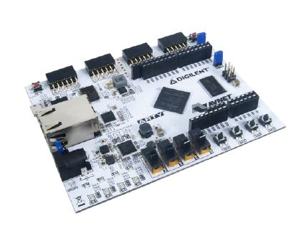
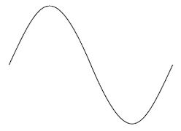
charles
?

Slide 3
General scheme
PWM
ANALOG INTERFACE
EN
1
3
V_{out}
PLL
ROM
BINARY COMPARATOR
COUNTER
DAC
PULSE GENERATOR
SHIFT REGISTER
INTERFACE LOGIC
4
V_{out}
CLK
2

Slide 4

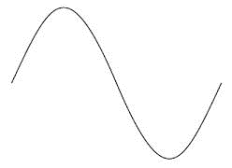
pwm
???

Slide 5
Vai giulia

Slide 6
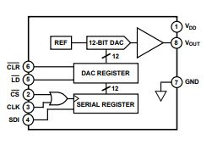
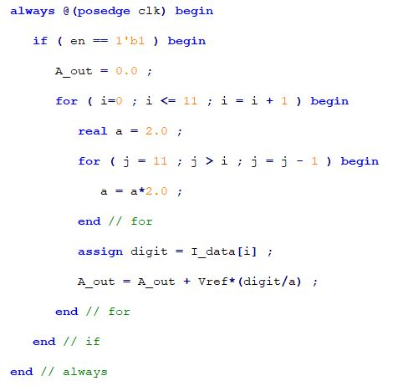
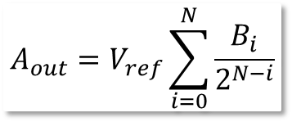
the dac (digital to analog converter)
$$A_{out}=V_{ref}\sum_{i=0}^{N}{\frac{B_{i}}{2^{N−i}}}$$
CLR: set all the data on the DAC REGISTER to 0 (not used in the project)
LD: enables data recording on the DAC REGISTER
CS: enables data shifting on the SERIAL REGISTER
CLK: allows synchronus transmission
SDI: serial data input

Slide 7
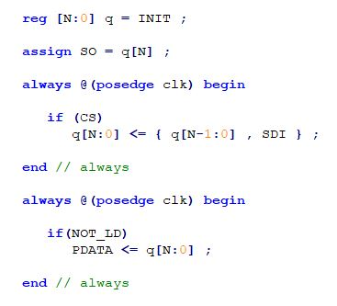
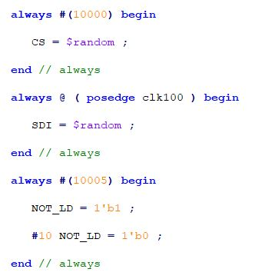
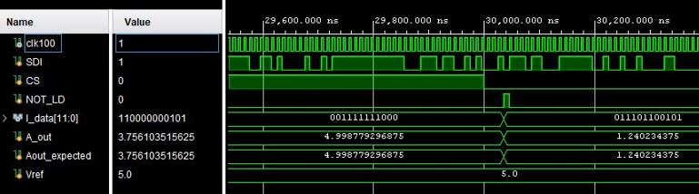
The DAC serial interface implementation
SIPO 12 BIT SHIFT REGISTER
NOT SYNTHESIZEBLE ON THE FPGA CHIP
12
CS
12 BIT SHIFT REGISTER
1
I_data
4
SDI
2
LD
3
SYSTEM VERILOG CODE
CLK
4
The DAC BEHAVIOURAL simulation

Slide 8
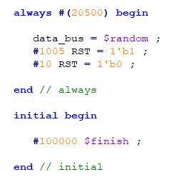
The FPGA set up
TARGET
IMPLEMENTED MODULE
SYNTHESIZEBLE ON THE FPGA CHIP
SIMULATION OF A REAL TRANSMITTER
TRANSMITTER SIMULATION
NEED TO TRANSMIT THE DATA CORRECTLY
TRANSMISSION INTERFACE
VERILOG CODE
Transmitter simulation
Data_bus
1
32
COUNTER
4
SO
RST
2
1 BYTE SHIFT REGISTER
5
LD_pdata
CLK
3

Slide 9
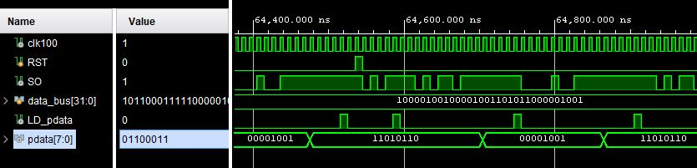
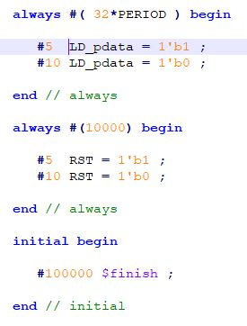
TRANSMISSION INTERFACE
BEHAVIOURAL SIMULATION OF THE TRASNMITER SIMULATION MODULE
LD_pdata
1
COUNTER
4
CS
TEST BENCH CODE FOR THE TRASMISSION INTERFACE MODULE
RST
2
1 BYTE SHIFT REGISTER
5
LD
CLK
3

Slide 10
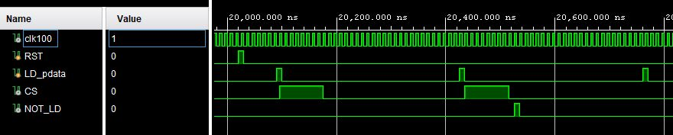
The TOP LEVEL MODULE
BEHAVIOURAL SIMULATION OF THE TRASMISSION INTERFACE MODULE
dac_enable
PLL
PULSE GENERATOR
ROM
TRASMITTER SIMULATION
TRANSMISSION INTERFACE
DAC
1
3
V_{out}
CLK
2

Slide 11
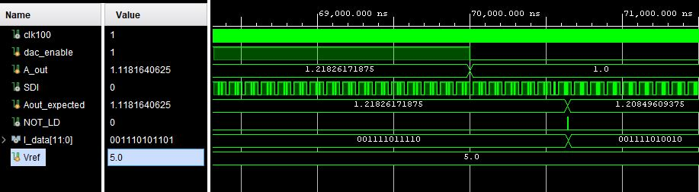
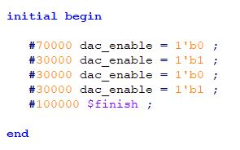
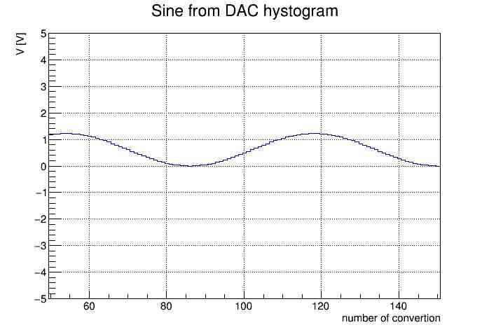
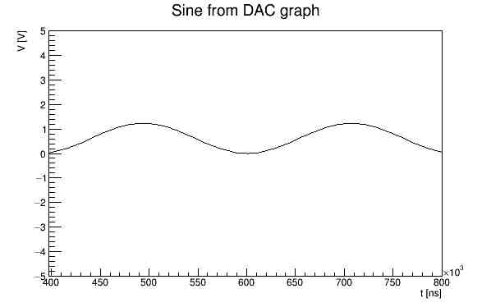
TEST BENCH CODE FOR THE TOP LEVEL MODULE
BEHAVIOURAL SIMULATION OF THE TOP LEVEL MODULE
USING VERILOG TASKS AND A PYTHON SCRIPT IS POSSIBLE TO WRITE THE DATA IN A ASCII FILE AND PLOT THEM

Slide 12
Aknoledgment (o come in qualunque cacchio di modo si scriva questa parola)
THANK YOU CHARLES
WE REALLY LOVE YOU

